Slide 1
Data Structures Week 9
Further Data Structures
The story so far
  Saw some fundamental operations as well as advanced operations on arrays, stacks, and queues
  Saw a dynamic data structure, the linked list, and its applications.
  Saw the hash table so that insert/delete/find can be supported efficiently.
  Saw trees and and applications to searching.
This week we will
  Introduce graphs as a data structure.
  Study operations on graphs including searching.

Slide 2
Data Structures Week 9
Introduction to Graphs
Consider the following problem.
A river with an island and bridges.
The problem is to see if there is a way to start from some landmass and using each bridge exactly once, return to the starting point.

Slide 3
Data Structures Week 9
Introduction to Graphs
The above problem dates back to the 17th century.
Several people used to try to solve it.
Euler showed that no solution exists for this problem.
Further, he exactly characterized when a solution exists.
By solving this problem, it is said that Euler started the study of graphs.

Slide 4
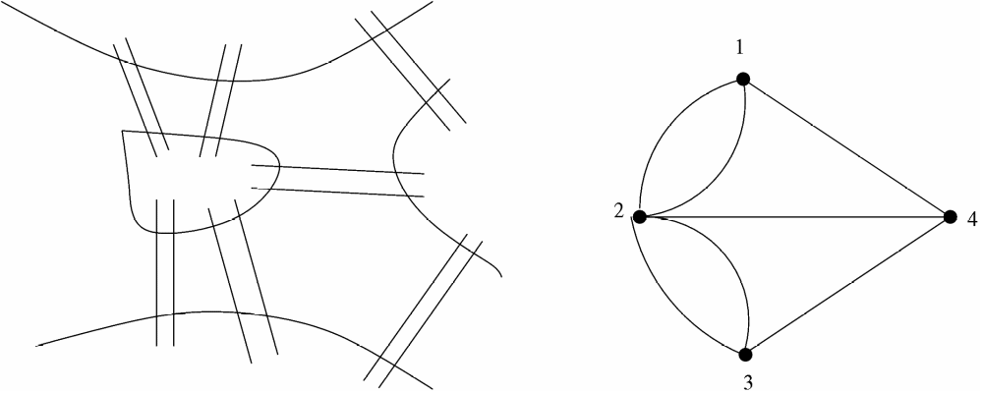
Data Structures Week 9
Introduction to Graphs
The figure on the right shows the same situation modeled as a graph.
There exist several such classical problems where graph theory has been used to arrive at elegant solutions.

Slide 5
Data Structures Week 9
Introduction to Graphs
Another such problem: In any set of at least six persons, there are either three mutual acquaintances or three mutual strangers.

Slide 6
Data Structures Week 9
Introduction to Graphs
Formally, let V be a set of points, also called as vertices.
Let E ⊆ VxV be a subset of the cross product of V with itself. Elements of E are also called as edges.
A graph can be seen as the tuple (V, E). Usually denoted by upper case letters G, H, etc.

Slide 7
Data Structures Week 9
Our Interest
Understand a few terms associated with graphs.
Study how to represent graphs in a computer program.
Study how traverse graphs.
Study mechanisms to find paths between vertices.
Spanning trees
And so on...

Slide 8
Data Structures Week 9
Few Terms
Recall that a graph G = (V, E) is a tuple with E being a subset of VxV.
Scope for several variations: for u, v in V
  Should we treat (u,v) as same as (v,u)?

Slide 9
Data Structures Week 9
Few Terms
Recall that a graph G = (V, E) is a tuple with E being a subset of VxV.
Scope for several variations: for u, v in V
  Should we treat (u,v) as same as (v,u)? In this case, the graph is called as a undirected graph.
  Treat (u,v) as different from (v,u).

Slide 10
Data Structures Week 9
Few Terms
Recall that a graph G = (V, E) is a tuple with E being a subset of VxV.
Scope for several variations: for u, v in V
  Should we treat (u,v) as same as (v,u)? In this case, the graph is called as a undirected graph.
  Treat (u,v) as different from (v,u). In this case, the graph is called as a directed graph.
  Should we allow (u,u) in E? Edges of this kind are called as self-loops.

Slide 11
Data Structures Week 9
Undirected Graphs
1
2
8
3
7
4
6
5
In this case, the edge (u,v) is same as the edge (v,u).
  Normally written as edge uv.

Slide 12
Data Structures Week 9
Undirected Graphs
The degree of a node v in a graph G = (V,E) is the number of its neighbours.
  It is denoted by d(v).
In the above example, the degree of vertex 4 is 4. The neighbors of vertex 4 are {3, 5, 6, 7}.
The degree of a graph G = (V,E) is the maximum degree of any node in the graph and is denoted Δ(G). Sometimes, written as just Δ when G is clear from the context.
  Thus, Δ = max_{v∈V} d(v).
  Thus Δ = 6 for the above graph.

Slide 13
Data Structures Week 9
Some Terms
In a graph G = (V,E), a path is a sequence of vertices v1, v2, · · · , vi, all distinct, such that v_{k}v_{k+1} ∈ E for 1 ≤ k ≤ i − 1.
If, under the above conditions, v1 = vi then it is called a cycle.
The length of such a path(cycle) is i − 1(resp. i).
An example: 3 – 8 – 5 – 2 in the above graph is a path from vertex 3 to vertex 2.
Similarly, 2 – 7 – 6 – 5 – 2 is a cycle.

Slide 14
Data Structures Week 9
Directed Graphs
1
2
3
4
6
5
In this case, the edge (u,v) is distinct from the edge (v,u).
  Normally written as edge 〈u, v〉.

Slide 15
Data Structures Week 9
Directed Graphs
Have to alter the definition of degree as
in-degree(v) : the number of neighbors w of v such that (w,v) in E.
out-degree(v) : the number of neighbors w of v such that (v,w) in E.
in-degree(4) = 1
out-degree(2) = 2.

Slide 16
Data Structures Week 9
Directed Graphs
Have to alter the definition of path and cycle to directed path and directed cycle.

Slide 17
Data Structures Week 9
Representing Graphs
How to represent graphs in a computer program.
Several ways possible.

Slide 18
Data Structures Week 9
Adjacency Matrix
The graph is represented by an n × n–matrix where n is the number of vertices.
Let the matrix be called A. Then the element A[i, j] is set to 1 if (i, j) ∈ E(G) and 0 otherwise, where 1 ≤ i, j ≤ n.
The space required is O(n²) for a graph on n vertices.
By far the simplest representation.
Many algorithms work very efficiently under this representation.

Slide 19
Data Structures Week 9
Adjacency Matrix Example
A
1 2 3 4 5 6
1
4
1
2
3
4
5
6
0
1
0
1
1
0
1
0
1
0
1
0
0
1
0
1
0
1
1
0
1
0
0
0
1
1
0
0
0
0
0
0
1
0
0
0
2
6
5
3

Slide 20
Data Structures Week 9
Adjacency Matrix Observations
Space required is n²
The matrix is symmetric and 0,1—valued.
  For directed graphs, the matrix need not be symmetric.
Easy to check for any u,v whether uv is an edge.
Most algorithms also take O(n²) time in this representation.
The following is an exception: The Celebrity Problem.

Slide 21
Data Structures Week 9
Adjacency List
Imagine a list for each vertex that will contain the list of neighbours of that vertex.
The space required will only be O(m).
However, one drawback is that it is difficult to check whether a particular pair (i, j) is an edge in the graph or not.

Slide 22
Data Structures Week 9
Adjacency List Example
1
2
3
4
5
6
2
5
4
1
4
5
1
3
2
6
2
6
4
6
1
3
5
3
1
2
3

Slide 23
Data Structures Week 9
Adjacency List
Useful representation for sparse graphs.
Extends to also directed graphs.

Slide 24
Data Structures Week 9
Other Representations
Neighbor maps

Slide 25
Data Structures Week 9
Searching Graphs
A fundamental problem in graphs. Also called as traversing a graph.
Need to visit every vertex.
Can understand several properties of a graph using a traversal.
Two main techniques : breadth first search, and depth first search.

Slide 26
Data Structures Week 9
Breadth First Search
Recall level order traversal of a tree.
  Starting from the root, visits every vertex in a level by level manner.
Let us develop breadth first search as an extension of breadth first search.

Slide 27
Data Structures Week 9
Breadth First Search
For a graph, no notion of a root vertex.
So, have to specify a starting vertex. Typically denoted s.
Still other problems exist.

Slide 28
Data Structures Week 9
Breadth First Search
In a tree, using level order traversal, each vertex is visited also exactly once.
  Why?

Slide 29
Data Structures Week 9
Breadth First Search
In a tree, using level order traversal, each vertex is visited also exactly once.
  Recall that a tree is connected and has no cycles.

Slide 30
Data Structures Week 9
Breadth First Search
In a tree, using level order traversal, each vertex is visited also exactly once.
  Recall that a tree is connected and has no cycles.
In a graph, that is no longer guaranteed.
  Start from s = 2.
1
2
5

Slide 31
Data Structures Week 9
Breadth First Search
In a tree, using level order traversal, each vertex is visited also exactly once.
  Recall that a tree is connected and has no cycles.
In a graph, that is no longer guaranteed.
  Start from s = 2.
  One of 1 or 5 visited more than once.
1
2
5

Slide 32
Data Structures Week 9
Breadth First Search
How to resolve that problem?
1
2
5

Slide 33
Data Structures Week 9
Breadth First Search
How to resolve that problem?
Can remember if a vertex is already visited.
Each vertex has a state among VISITED, NOT_VISITED, IN_PROGRESS.
Why three states instead of just two?
  Need them for a later use.
1
2
5

Slide 34
Data Structures Week 9
Breadth First Search
Another problem is with respect to some vertices that cannot be reached from s.
For example, when s = 2, vertex 3 can never be visited.
What to do with those vertices?
Answer depends on the idea behind graph searching via BFS.
1
3
2
5

Slide 35
Data Structures Week 9
Breadth First Search
The basic idea of breadth first search is to find the least number of edges between s and any other vertex in G.
  The same property holds for level order traversal of a tree also with s as the root.
Starting from s, we can thus visit vertices of distance k before visiting any vertex of distance k+1.
For that purpose, define d_{s}(v) to be the least number of edges between s and v in G.

Slide 36
Data Structures Week 9
Breadth First Search
So, for vertices v that are not reachable from s, can say that d_{s}(v) is ∞.
Alike a level order traversal of a tree, can use a queue to store vertices in progress.

Slide 37
Data Structures Week 9
BFS Procedure
Procedure BFS(G)‏
for each v ∈ V do
π(v)= NIL;colour[v] = RED; d(v) = ∞;
End-for
d[s] = 0; colour[s] = YELLOW; π[s]= NIL, Q = EMPTY; Q.Enqueue(s);
While Q is not empty do
v = Q.Dequeue();
for each neighbour w of v do
if colour[w] = RED then
colour[w] = YELLOW; π[w] = v;
d[w] = d[v] + 1; Q.Enqueue(w);
end-if
colour[v] = GREEN
end-for
end-while

Slide 38
Data Structures Week 9
BFS Example
Start from s = 2.
1 2 3 4 5 6
1
4
d : ∞ 0 ∞ ∞ ∞ ∞
π : − − − − − −
2
6
6
5
3

Slide 39
Data Structures Week 9
BFS Example
Start from s = 2.
1 2 3 4 5 6
1
4
d : ∞ 0 ∞ ∞ ∞ ∞
π : − − − − − −
2
6
6
d : 1 0 1 ∞ 1 2
π : 2 − 2 − 2 3
d : 1 0 1 2 1 2
π : 2 − 2 1 2 3
5
3

Slide 40
Data Structures Week 9
BFS
The runtime of BFS is O(m+n)
  Each vertex enters the queue at most once.
  Each edge is considered only once.
The value of a vertex v denotes the vertex u that discovered v.
The π values maintained during BFS can be used to define a tree as follows.
Define the predecessor subgraph of G = (V,E) as
  G π = (V π,E π) where
  V π = {v ∈ V : π(v) != NULL} U {s} and
  E π = {(π(v), v) ∈ E : v ∈ V π − {s}}.

Slide 41
Data Structures Week 9
BFS Example Contd...
1
4
2
6
5
3

Slide 42
Data Structures Week 9
Properties BFS
Notice that once color of a vertex v changes YELLOW, then d_{s}(v) can never change after that.
At that time, v has entered the queue.
Can classify edges of G according to BFS from a given s as follows.

Slide 43
Data Structures Week 9
Classifying Edges
The edges of E π are also called as tree edges.
It holds that for a tree edge (u, v), d(v) = d(u) + 1.
The edges of E_{N} := E \ E π are called as non-tree edges.
These edges can be further classified as follows.

Slide 44
Data Structures Week 9
Classifying Edges
An edge (u, v) ∈ E_{N} is called as a back edge if d_{s}(v) < d_{s}(u).
In other words, u can be reached from s via v, but there is yet another shortest path through path u can be reached from s.
An edge (u, v) ∈ E_{N} is called a cross edge if d(v) ≤ d(u) + 1.

Slide 45
Data Structures Week 9
Directed or Undirected
Most of the above observations hold even if G is directed.
Can thus extend the notion of BFS to directed graphs.

Slide 46
Data Structures Week 9
Towards Weighted BFS
So, far we have measured d_{s}(v) in terms of number of edges in the path from s to v.
Equivalent to assuming that each edge in the graph has equal (unit) weight.
But, several settings exist where edges may have unequal weights.

Slide 47
Data Structures Week 9
Towards Weighted BFS
Consider a road network.
Junctions can be vertices and roads can be edges.
Can use such a graph to find the best way to reach from point A to point B.
Best here can mean shortest distance/shortest delay/....
Clearly, all edges need not have the same distance/delay/.

Slide 48
Data Structures Week 9
Towards Weighted BFS
Delhi
1200
450
1100
800
Nagpur
Kolkata
Mumbai
300
800
150
500
450
Hyderabad
Pune
260
Visakhapatnam
450
Vijayawada
Bangalore
300
Chennai

Slide 49
Data Structures Week 9
A Few Problems
Problem I : Given two points u and v, find the shortest distance between them.
Problem II : Given a starting point s, find the shortest distance from s to all other points.
Problem III : Find the shortest distance between all pairs of points.

Slide 50
Data Structures Week 9
A Few Problems
Turns out that Problem I is not any easier than Problem II.
Problem III is definitely harder than Problem II.
We shall study problem II, and possibly Problem III.

Slide 51
Data Structures Week 9
Weighted Graphs
The setting is more general.
A weighted graph G = (V, E, W) is a graph with a weight function W : E –> R.
Weighted graphs occur in several setting
  Road networks
  Internet

Slide 52
Data Structures Week 9
Problem II : Single Source Shortest Paths
Problem II is also called the single source shortest paths problem.
Let us extend BFS to solve this problem.
Notice that BFS solves the problem when all the edge weights are 1.
  Hence the reason to extend BFS

Slide 53
Data Structures Week 9
SSSP
Extensions needed
  1. Weights on edges

Slide 54
Data Structures Week 9
SSSP
Extensions needed
  1. Weights on edges
  2. How to know when a node is finished. Would it suffice if a vertex is in the queue?

Slide 55
Data Structures Week 9
SSSP
Extensions needed
  1. Weights on edges
  2. How to know when a node is finished. Would it suffice if a vertex is in the queue?
For a vertex v, d_{s}(v) will now refer to the shortest distance from s to v.
Initially, like in BFS, d_{s}(v) = ∞ for all vertices v except s, and d_{s}(s) = 0.

Slide 56
Data Structures Week 9
Weighted BFS
s
v
w
d_{s}(v)
W(v,w)
Also, weights on edges mean that if v is a neighbor of w in the shortest path from s to w, then d_{s}(w) = d_{s}(v) + W(v,w).
  Instead of d_{s}(w) = d_{s}(v) + 1 as in BFS.
We will call this as the first change to BFS.

Slide 57
Data Structures Week 9
SSSP
Notice that in BFS a node has three states : NOT_VISITED, VISITED, IN_QUEUE
A vertex in VISITED state should have no more changes to d_{s}() value.
What about a vertex in IN_QUEUE state?
  such a vertex has some finite value for d_{s}(v).
  Can d_{s}(v) change for such vertices?
  Consider an example.

Slide 58
Data Structures Week 9
Weighted BFS
Consider s = 2 and perform weighted BFS.
1
4
10
5
3
4
2
6
6
10
3
5
5
3

Slide 59
Data Structures Week 9
Weighted BFS
Consider s = 2.
From s, we will enqueue1, 5, and 3 with d(1) = 4, d(5) = 10, d(3) = 3, in that order.
While vertex 5 is still in queue, can visit 5 from vertex 1 also.
1
4
10
5
3
4
2
6
6
10
3
5
5
3

Slide 60
Data Structures Week 9
Weighted BFS
Moreover, the weight of the edge 2- 5 is 10 whereas there is a shorter path from 2 to 5 via the path 2 – 1 – 5.
So, it suggests that d(v) should be changed while v is still in the queue.
1
4
10
5
3
4
2
6
6
10
3
5
5
3

Slide 61
Data Structures Week 9
Weighted BFS
While v is in queue, we can check if d(v) is more than the distance along the new path.
If so, then update d(v) to the new smaller value.
Change 2 to BFS.
1
4
10
5
3
4
2
6
6
10
3
5
5
3

Slide 62
Data Structures Week 9
Weighted BFS
Does that suffice?
In the same example, if we change the order of vertices from 1, 5, 3 to 5, 1, 3, then vertex 5 will not be in queue when 1 is removed from the queue.
1
4
10
5
3
4
2
6
6
10
3
5
5
3

Slide 63
Data Structures Week 9
Weighted BFS
So, the simple fix to change d(v) while v is still in queue does not work.
May need to update d(v) even when v is not in queue?
  But how long should we do so?

Slide 64
Data Structures Week 9
Weighted BFS
Can do so as long as there are changes to some d(v)?
  No need of a queue then, in this case really.
Will this ever stop?
Indeed it does. Why?
  Intuitively, there are only a finite number of edges in any shortest path.

Slide 65
Data Structures Week 9
An Algorithm for SSSP
Algorithm SSSP(G,s)‏
begin
  for all vertices v do
    d(v) = infty; π(v) = NIL;
  end-for
  for n-1 iterations do
    for each edge (v,w) do
      if d(w) > d(v) + W(v,w) then
        d(w) = d(v) + W(v,w); π(w) = v;
      end-if
    end-for
  end-for
end

Slide 66
Data Structures Week 9
Algorithm SSSP
The above algorithm is called the Bellman-Ford algorithm.
The algorithm requires O(mn) time.
  For each of the n-1 iterations, we consider each edge once.
  Has O(1) compute per edge.

Slide 67
Data Structures Week 9
Example Algorithm SSSP
Start vertex = d. Employ the Bellman-Ford algorithm to find shortest path from d to all other vertices.
a
5
c
4
e
1
2
3
b
6
d

Slide 68
Data Structures Week 9
Algorithm SSSP
The time taken by the Bellman-Ford algorithm is too high compared to that of BFS.
Can we improve on the time requirement?
Most of the time is due to

Slide 69
Data Structures Week 9
Algorithm SSSP
The time taken by the Bellman-Ford algorithm is too high compared to that of BFS.
Can we improve on the time requirement?
Most of the time is due to
  Repeatedly considering edges
  Updating d(v) possibly many times
Need to know how to stop updating d(v) for any vertex v.
This is what we will develop next.

Slide 70
Data Structures Week 9
To Improve the Runtime
When is a vertex DONE?
When no further shorter path can be found to v from s.
  Equivalently, when d(v) can no longer decrease.
For this to happen, consider the following.
  A few vertices, say S, are DONE.
  Plus, all the edges with one endpoint in S are considered.
  Other vertices in V \ S, have some d() value.
  Which of these cannot improve d() any more?

Slide 71
Data Structures Week 9
To Improve the Runtime
We say that an edge is considered in the following sense.
Let e = (v,w) be an edge. Run the following program for edge e.
void process(e) /*e = (v,w)*/
begin
if d(w) > d(v) + W(v,w) then
d(w) = d(v) + W(v,w)
end
end

Slide 72
Data Structures Week 9
The Setting
G
S
E
20
D
22
15
Z
B
A
W
16
s
X
12
V
F
U
6
24
Y
22
C
Green vertices are DONE.
Edges with at least one end point as a green vertex are the ONLY edges processed.
Numbers on black vertices indicate their d() value using only green vertices as intermediate vertices.

Slide 73
Data Structures Week 9
The Setting
G
S
E
20
D
22
15
Z
B
A
W
16
s
X
12
V
F
U
6
24
Y
22
C
which of the black vertices is done?

Slide 74
Data Structures Week 9
The Setting
G
S
E
20
D
22
15
Z
B
A
W
16
s
X
12
V
F
U
6
24
Y
22
C
Notice that there could be edges between the black vertices also.
  None of them are processed so far.
But each edge has a positive weight.

Slide 75
Data Structures Week 9
The Setting
G
S
E
20
D
22
15
Z
B
A
W
16
s
X
12
V
F
U
6
24
Y
22
C
A vertex with the smallest d() value among the black vertices can no longer improve its d() value.
  Why?

Slide 76
Data Structures Week 9
The Setting
G
S
E
20
D
22
15
Z
B
A
W
16
s
X
12
V
F
U
6
24
Y
22
C
A vertex with the smallest d() value among the black vertices can no longer improve its d() value.
  Why? Any more change would involve using at least one more edge between two black vertices.

Slide 77
Data Structures Week 9
The Setting
G
S
E
20
D
22
15
Z
B
A
W
16
s
X
12
V
F
U
6
24
Y
22
C
Suggests that the vertex with the smallest d() value can be moved to the set S.

Slide 78
Data Structures Week 9
The Setting
G
S
E
20
D
22
15
Z
B
A
W
16
s
X
12
V
F
U
6
24
Y
22
C
Suggests that the vertex with the smallest d() value can be moved to the set S.
But, how did we pick the set S so far?

Slide 79
Data Structures Week 9
The Setting
G
S
E
20
D
22
15
Z
B
A
W
16
s
X
12
V
F
U
6
24
Y
22
C
Initially, only vertex s is in the set S.
  As d(s) = 0.
Incrementally, populate S with more vertices.

Slide 80
Data Structures Week 9
The Algorithm
Can develop the above idea into an algorithm.
The basic step in the algorithm is to proceed iteratively.
Each iteration, one vertex is moved to set S according to the least d() rule.

Slide 81
Data Structures Week 9
The Algorithm
What is the effect of moving a vertex v to S?
  The neighbors of v may find a better path from s.
  So, we will update d(w) for neighbors w of v, if necessary.
Every neighbor of v?

Slide 82
Data Structures Week 9
The Algorithm
What is the effect of moving a vertex v to S?
  The neighbors of v may find a better path from s.
  So, we will update d(w) for neighbors w of v, if necessary.
Every neighbor of v?
No, those in S can never decrease their d() value.
  So, check only neighbors w that are not in S.

Slide 83
Data Structures Week 9
The Algorithm
Algorithm SSSP(G, s)‏
begin
  for all vertices v do
    d(v) = infinity; p(v) = NIL;
  end-for
  d(s) = 0;
  for n iterations do
    v = the vertex with the least d() value among V \ S;
    Add v to S
    for each neighbor w of v in V \ S do
      d(w) = min { d(w), d(v) + W(v,w) }
    end-for
  end-for

Slide 84
Data Structures Week 9
The Algorithm
The program resembles the BFS approach.
  Instead of a queue, maintain order on the vertices according to their d() values.
  Need three states now.
The above algorithm is essentially the Dijkstra's algorithm.
How to analyze the above algorithm?
Requires answers to a few questions.
How to know which vertex in V \ S has the least d() value?
How to know if a vertex is in V \ S or not?

Slide 85
Data Structures Week 9
The Algorithm
How to know which vertex in V \ S has the least d() value?
  Think of the binary heap.
  A heap supports an efficient deleteMin().
  Use d() values as the priority.
How to update d(v) for a vertex v?

Slide 86
Data Structures Week 9
The Algorithm
How to know which vertex in V \ S has the least d() value?
  Think of the binary heap.
  A heap supports an efficient deleteMin().
  Use d() values as the priority.
How to update d(v) for a vertex v?
  Use DecreaseKey(v).
How to verify if a vertex v is in S or V\S?

Slide 87
Data Structures Week 9
The Algorithm
How to know which vertex in V \ S has the least d() value?
  Think of the binary heap.
  A heap supports an efficient deleteMin().
  Use d() values as the priority.
How to update d(v) for a vertex v?
  Use DecreaseKey(v).
How to verify if a vertex v is in S or V\S?
  Use a flag.

Slide 88
Data Structures Week 9
The Algorithm
To analyze the algorithm when using a heap
  A heap is built out of the n nodes.
  There are n DeleteMin() operations.
  There are at most m DecreaseKey() operations.
Each DeleteMin() takes O(log n) time
Each DecreaseKey() operation takes O(log n) time.
So, the total time is O((n+m)log n).

Slide 89
Data Structures Week 9
Advanced Solutions
Advanced data structures exist to decrease the runtime to O(m + n log n ).
  Fibonacci heaps, ...
A good case study of how to separate algorithm from the data structure.
  Any data structure that supports deleteMin and decreaseKey can be used
  The algorithm will still be correct.

Slide 90
Data Structures Week 9
Example
Start vertex is d.
a
5
c
4
e
1
2
3
b
6
d

Slide 91
Data Structures Week 9
Yet Another Traversal
In BFS, vertices not reachable from s are never listed.
So the entire graph may not be visited at all.
We will study yet another traversal mechanism for graphs.
This is called depth first search (DFS) and has important applications.
Several graph algorithms use DFS as a subroutine.

Slide 92
Data Structures Week 9
Depth First Search
The idea of DFS is as follows.
Start from a specified start vertex, say s.
Explore from s as deep as possible. This suggests that we go from s, to one of its neighbors x, to a neighbor of x, and so on.
When to stop? When there are no new neighbors to explore from a given point.
What if all vertices are not visited?
  Pick another start vertex from such vertices.

Slide 93
Data Structures Week 9
Depth First Search
Alike BFS, have to keep track of a the state of a vertex.
A vertex can be in three states: VISITED, NOT_VISITED, IN_PROCESS
Why the third state? Same reason as BFS.

Slide 94
Data Structures Week 9
Depth First Search
When at a vertex v, search proceeds as follows:
If there are still vertices not visited, start with any of them. See the code above, right.
Explore(v)
begin
for each neighbor w of v
if w is not visited then
color(w) = YELLOW;
Explore(w);
end-if
end-for
color(v) = Green;
end
DFS(G)
begin
for v = 1 to n do
begin
if color(v) == RED then
color(v) = YELLOW;
Explore(v)
end
end
end

Slide 95






Data Structures Week 9
DFS – An Example

Slide 96






Data Structures Week 9
DFS – An Example

Slide 97
Data Structures Week 9
DFS – An Example

Slide 98
Data Structures Week 9
DFS – An Example

Slide 99
Data Structures Week 9
DFS – An Example

Slide 100
Data Structures Week 9
DFS – An Example

Slide 101
Data Structures Week 9
DFS – An Example

Slide 102
Data Structures Week 9
DFS – An Example

Slide 103
Data Structures Week 9
DFS – An Example

Slide 104
Data Structures Week 9
DFS – An Example

Slide 105
Data Structures Week 9
DFS – An Example

Slide 106
Data Structures Week 9
DFS – An Example

Slide 107
Data Structures Week 9
DFS – An Example

Slide 108
Data Structures Week 9
Discovery and Finish Times
With every vertex, can also associate start and finish times.
Start with time = 0 at the beginning.
Increment time for the following events
  A new vertex is discovered
  A discovered vertex finishes processing.

Slide 109
Data Structures Week 9
Discovery and Finish Times
The first time a vertex v changes state from NOT_VISITED to IN_PROCESS, the current time is recorded as the discovery time of v,
  denoted d(v)‏
The time at which vertex v changes state from IN_PROCESS to VISITED is recorded as the finish time of v
  denoted f(v)‏

Slide 110
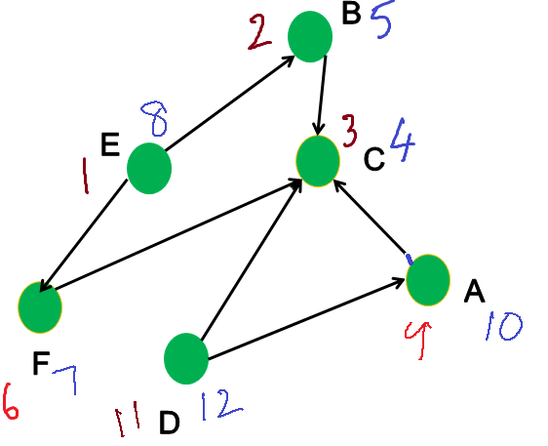

Data Structures Week 9
Discovery and Finish Times – Example

Slide 111
Data Structures Week 9
Discovery and Finish Times
Several graph properties can be observed using the d() and the f() times.
Interesting algorithms can be designed relying mostly on d() and f() times.
We will see at least one such example later.

Slide 112
Data Structures Week 9
Classifying Edges
Set π(v) = u if u discovered v.
Defines a graph(Tree) T = (V’, E’) with
  V’ = V, E’ = {(u,v) | π(v) = u }.
The edges of E’ are also called as tree edges.
The edges of E_{N} := E \ E’ are called as non-tree edges.
These edges can be further classified as follows.

Slide 113
Data Structures Week 9
Classifying Edges
Back Edges
  An edge (u, v) ∈ E_{N} is called as a back edge if v is an ancestor of u in the tree.
  In other words, u can be reached from v using tree edges, but there an edge from u to v also.
Forward Edge
  Edges (u, v) which connect a vertex u to a descendant of u in the DFS tree.
  In other words, v can be reached from u using tree edges, but there an edge from u to v also.

Slide 114
Data Structures Week 9
Classifying Edges
Cross Edges : Edges (u, v) where u and v do not share any ancestor/descendant relationship.
Depending on the type of the edge, certain relations between d() and f() values of the endpoints hold.
Find other such relations.

Slide 115
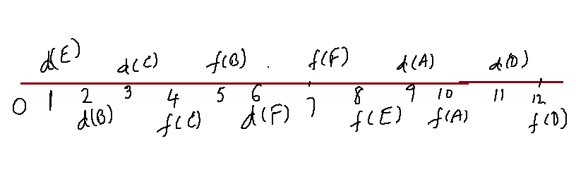






Data Structures Week 9
Discovery and Finish Time in Intervals

Slide 116
Data Structures Week 9
Classify Edges via d() and f() Times
Tree Edges.

Slide 117
Data Structures Week 9
pClassify Edges via d() and f() Times
Tree Edges.
  Easy to identity as π(v) = u for tree edge (u,v)

Slide 118
Data Structures Week 9
Classify Edges via d() and f() Times
Tree Edges.
  Easy to identity as π(v) = u for tree edge (u,v)
Back Edges

Slide 119
Data Structures Week 9
Classify Edges via d() and f() Times
Tree Edges.
  Easy to identity as π(v) = u for tree edge (u,v)
Back Edges
  (u, v) is a back edge if [d(u), f(u)] is a subinterval of [d(v), f(v)]

Slide 120
Data Structures Week 9
Classify Edges via d() and f() Times
Tree Edges.
  Easy to identity as π(v) = u for tree edge (u,v)
Back Edges
  (u, v) is a back edge if [d(u), f(u)] is a subinterval of [d(v), f(v)]
Forward Edges

Slide 121
Data Structures Week 9
Classify Edges via d() and f() Times
Tree Edges.
  Easy to identity as π(v) = u for tree edge (u,v)
Back Edges
  (u, v) is a back edge if [d(u), f(u)] is a subinterval of [d(v), f(v)]
Forward Edges
  (u, v) is a forward edge if [d(v), f(v)] is a subinterval of [d(u), f(u)].

Slide 122
Data Structures Week 9
Classify Edges via d() and f() Times
Tree Edges.
  Easy to identity as π(v) = u for tree edge (u,v)
Back Edges
  (u, v) is a back edge if [d(u), f(u)] is a subinterval of [d(v), f(v)]
Forward Edges
  (u, v) is a forward edge if [d(v), f(v)] is a subinterval of [d(u), f(u)].
Cross edges
  Neither of these

Slide 123
Data Structures Week 9
Application of DFS – I
Recall the bridges problem.
Suppose that more bridges are added but

Slide 124
Data Structures Week 9
Application of DFS – I
Recall the bridges problem.
Suppose one day all the bridges are made directional.
  made one-way
Directions decided arbitrarily.
Can we go from one point to another point, and also come back respecting the directions?

Slide 125
Data Structures Week 9
Applications of DFS – I
The general problem is as follows.
Given a directed graph G = (V, E) partition V into maximal subsets so that every pair of vertices in each set have a directed path between them.
  u, v in V_{i}, u is reachable form v and v is reachable from u.
Each such set is called a strongly connected component.

Slide 126
Data Structures Week 9
Applications of DFS – I
Can use DFS to find the strongly connected components of a given directed graph.
Requires a few thought questions.

Slide 127
Data Structures Week 9
Applications of DFS – I
C
v
C'
u
x
y
Let C, C' be two (distinct) strongly connected components of G.
Let u in C, and v in C' be such that (u,v) in an edge.
There cannot be an edge from some y in C' to an x in C.

Slide 128
Data Structures Week 9
Applications of DFS – I
C
v
C'
u
x
y
If such an edge (y,x) exists, then C and C' are not maximal.

Slide 129
Data Structures Week 9
Applications of DFS – I
C
v
C'
u
Given such C and C' and u, v such that (u,v) is an edge, in any DFS of G, C finishes after C'.
  Set f(C) = max_{v in C} f(v) for a component C.

Slide 130
Data Structures Week 9
Applications of DFS – I
C
v
C'
u
Given such C and C' and u, v such that (u,v) is an edge, in any DFS of G, C finishes after C'.
  Set f(C) = max_{v in C} f(v) for a component C.
Proof: Consider the case that d(u) < d(v).
Then, DFS from u clearly enters C' via (u,v) or some other edge.

Slide 131
Data Structures Week 9
Applications of DFS – I
C
v
C'
u
d(u)‏
d(v)‏
f(C')‏
f(C)‏
Thus, v would be a descendant of u.
Once DFS enters C', all vertices of C' would be visited before backtracking to a vertex in C.
Thus, C' finishes before C.

Slide 132
Data Structures Week 9
Applications of DFS – I
C
v
C'
u
d(v)‏
d(u)‏
f(C')‏
f(C)‏
Similar observations hold also if d(u) > d(v).
In this case, DFS from v has to finish C' and cannot enter C.
So, f(C) is also larger than f(C')‏

Slide 133
Data Structures Week 9
Applications of DFS – I
C
v
C'
u
Define the graph G^{T} as follows
  V(G^{T}) = V(G)‏
  E(G^{T}) = { (v,w) | (w,v) in E(G)}
In essence, invert the directions of edges in G to get G^{T}.
The SCCs of G and G^{T} are identical.

Slide 134
Data Structures Week 9
Applications of DFS – I
C
v
C'
u
Why is that important?
Consider setting up a DFS in G^{T} so that
  the DFS will visit only vertices in each component.
How to set this up?

Slide 135
Data Structures Week 9
Applications of DFS – I
C
v
C'
u
Notice that in G^{T}, the edge (u,v) in G appears as (v,u).
Also, a DFS in G^{T} that starts in C cannot enter C'.
Why?

Slide 136
Data Structures Week 9
Applications of DFS – I
C
v
C'
u
How to do DFS in G^{T} such that it visits only vertices in one component before having to start again.
If in a DFS in G, C finishes later than C', then there is some vertex in C whose finish time is more than the finish time of all vertices in C'.
So, can start with such a vertex.

Slide 137
Data Structures Week 9
Applications of DFS – I
C
v
C'
u
Suggests that we should pick the start vertex for DFS in G^{T} such that it has the largest finish time among all vertices according to DFS in G.
Indeed, that is the algorithm for finding SCCs also.

Slide 138
Data Structures Week 9
Algorithm for SCC
Algorithm SCC(G)‏
begin
  perform a DFS in G and record the d() and f() times of all vertices.
  construct the graph G^{T} from G.
  Perform DFS in G^{T} picking vertices in decreasing order of finish time according to DFS in G
end

Slide 139
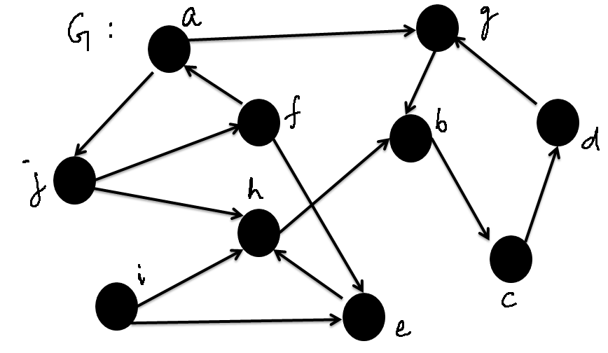
Data Structures Week 9
Example SCC

Slide 140
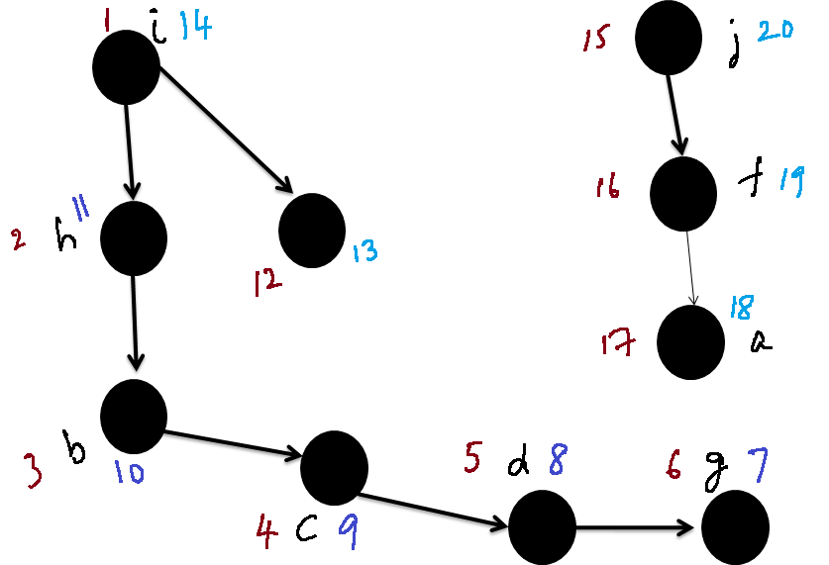

Data Structures Week 9
Example SCC: DFS on G

Slide 141
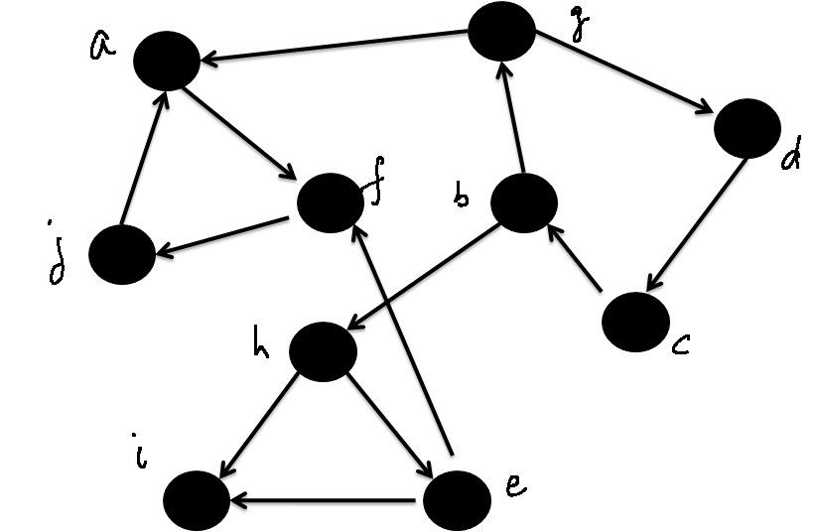
Data Structures Week 9
The Graph G^{T}

Slide 142
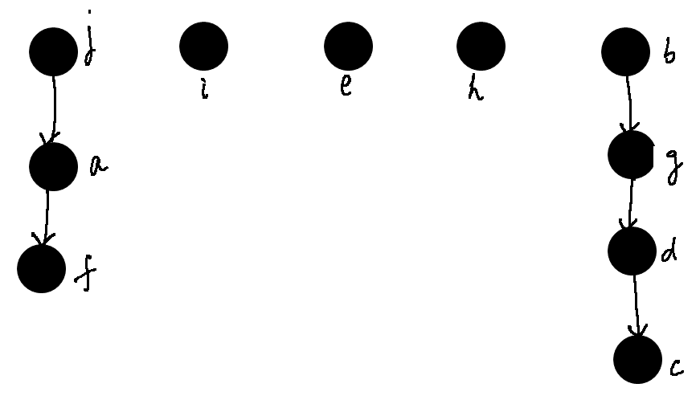
Data Structures Week 9
DFS on G^{T} With Specific Start Vertices

Slide 143
Data Structures Week 9
Application of DFS-II
We will now consider another famous problem in graphs.
Recall the bridges problem again.
The purpose of the bridge is to provide connectivity.
In reality, each bridge requires a certain cost to be built.

Slide 144
Data Structures Week 9
Spanning Trees
We will now consider another famous problem in graphs.
Recall the bridges problem again.
The purpose of the bridge is to provide connectivity.
In reality, each bridge requires a certain cost to be built.

Slide 145
Data Structures Week 9
Spanning Trees
So, there is a trade-off here.
How to provide connectivity while minimizing the total cost of building the bridges.
The weights on the edges indicate the cost of building that bridge.
The total cost of bridges = sum of all the bridge costs built.
26
25
29

Slide 146
Data Structures Week 9
Spanning Trees
Formalize the problem as follows.
Let G = (V, E, W) be a weighted graph.
Find a subgraph G' of G that is connected and has the smallest cost where cost is defined as the sum of the edge weights of edges in G'.

Slide 147
Data Structures Week 9
Spanning Trees
Observation I : If G' has a cycle and is connected, then there exists a G'', which is also a subgraph of G and is connected so that
cost(G'') < cost(G')‏
To get G'', simply break at least one cycle of G'.
Hence, the optimal G' shall have no cycles and is connected.
  Suggests that G' is a tree.

Slide 148
Data Structures Week 9
Spanning Trees
Two keywords : spanning and tree.
Some notation: A subgraph G' of G is called a spanning subgraph if V(G') = V(G).
A spanning subgraph G' of G that is also a tree is called as a spanning tree of G.

Slide 149
Data Structures Week 9
Spanning Trees
So, our problem can be reduced to “Find a spanning tree of G that has the least cost.”
Such a spanning tree is also called as a minimum spanning tree of G.

Slide 150
Data Structures Week 9
MST
Let us now think of devising an algorithm to construct an MST of a given weighted graph G.
There are several approaches, but let us consider a bottom-up approach.
Let us start with a graph (tree) that has no edges and add edges successively.
Every new edge we add should not create a cycle.
Further, the total cost of the final tree should be the least possible.

Slide 151
Data Structures Week 9
MST
Suggests that we should prefer edges of smaller weight.
  But should not add edges that create cycles.
Indeed, that is intuitive and turns out that is correct too.
  we will skip the proof of this.

Slide 152
Data Structures Week 9
MST Algorithm
Algorithm MST(G)‏
begin
  sort the edges of G in increasing order of weight as e₁, e₂, ..., e_{m}
  i = 1; E(T) = Φ
  while |E(T)| < n-1 do
      if E(T) U e_{i} does not have a cycle then
        E(T) = E(T) U e_{i}
      end-if
      i = i + 1;
  end-while
End.

Slide 153
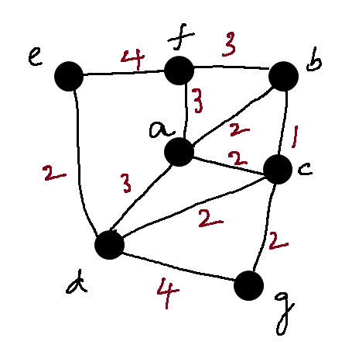
Data Structures Week 9
MST Example

Slide 154
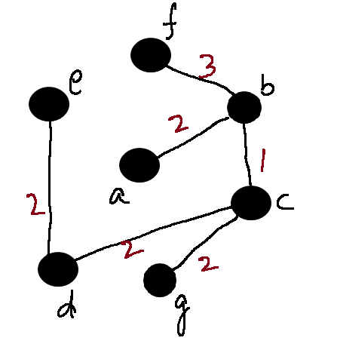
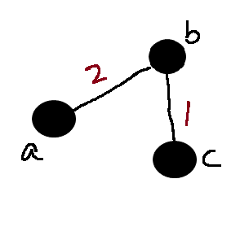
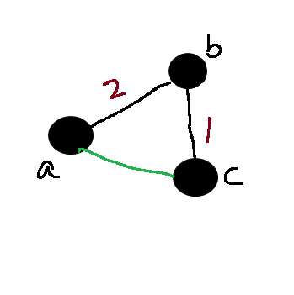
Data Structures Week 9
l
MST Example
List of edges by weight
  bc, ab, ac, cg, cd, de, bf, af, ad, ef, dg

Slide 155
Data Structures Week 9
MST Algorithm Analysis
The algorithm we devised is called the Kruskal's algorithm.
Belongs to a class of algorithms called greedy algorithms.
How do we analyze our algorithm?
  Need to know how to implement the cycle checker.

Slide 156
Data Structures Week 9
MST Algorithm Analysis
How quickly can we find if a given graph has a cycle?
  O(m+n) is possible.
Notice that if the graph is a forest, then m = O(n).
So, can be done in O(n) time.
Also, need to try all m edges in the worst case.
So the time required in this case is O(mn).

Slide 157
Data Structures Week 9
MST Algorithm Analysis
Too high in general.
But, advanced data structures exist to bring the time down close to O(m log n).
  Cannot be covered in this class.

Slide 158
Data Structures Week 9
MST – Another Approach
The previous approach has to check for cycles every iteration.
Another approach that has a smaller runtime even with basic data structures.
Largely simplifies the solution.

Slide 159
Data Structures Week 9
MST – Another Approach
The current approach is characterized by having a single tree T at any time.
In each iteration, T is extended by adding one vertex v not in T and one edge from v to some vertex in T.
Starting from a tree of one node, this process is repeated n-1 times.

Slide 160
Data Structures Week 9
MST – Another Approach
Two questions:
  How to pick the new vertex v?
  How to pick the edge to be added from v to some other vertex in T?

Slide 161
Data Structures Week 9
MST – Another Approach
The answers are provided by the following claims.
Claim 1: Let G = (V, E, W) be a weighted undirected graph. Let v be any vertex in G. Let vw be the edge of smallest weight amongst all edges with one endpoint as v. Then vw is always contained in any MST of G.

Slide 162
Data Structures Week 9
MST – Another Approach
Claim 1 can be shown in the following way.
For each vertex v in G, there must be at least one edge in any MST.
Considering the edge of the smallest weight is useful as it can decrease the cost of the spanning tree.

Slide 163
Data Structures Week 9
Generalizing Claim 1.
Claim 2 can be generalized further.
Let T be a subtree of some MST of an undirected weighted graph G. Consider edges uv in G such that u is in T and v is not in T. Of all such edges, let e = xy be the edge with the smallest weight. Then T U {e} is also a subtree of some MST of G.

Slide 164
Data Structures Week 9
Generalizing Claim 1.
Claim 2 allows us to expand a given sub-MST T.
We can use Claim 2 to expand the current tree T.
How to start?

Slide 165
Data Structures Week 9
Towards an Algorithm
Let v be any vertex in the graph G. Pick v as the starting vertex to be added to T.
T now contains one vertex and no edges.
T is a subtree of some MST of G.
Now, apply Claim 2 and extend T.

Slide 166
Data Structures Week 9
Towards an Algorithm
Algorithm MST(G, v)
Begin
Add v to T;
While T has less than n – 1 edges do
w = vertex s.t. vw has the smallest weight
amongst edges with one endpoint in T and another not in T.
Add vw to T.
End
End

Slide 167
MST : Example
B
7
D
10
3
A
F
5
3
2
2
C
E
5

Slide 168
MST : Example (Using Prim’s)
7
B
D
3
10
A
F
5
3
2
2
C
E
5
The green edges form the part of the MST. The vertices turn yellow in the order in which they will be included in the MST.

Slide 169
Data Structures Week 9
Towards an Algorithm
How to find w in the algorithm?
Need to maintain the weight of edges that satisfy the criteria.
A better approach:
  Associate a key to every vertex
  key[v] is the smallest weight of edges with v as one endpoint and another in the current tree T.
  key[v] changes only when some vertex is added to T.
  Vertex with the smallest key[v] is the one to be added to T.

Slide 170
Data Structures Week 9
Towards an Algorithm
Suggests that key[v] need to be updated only when a new vertex is added to T.
Further, not all key[v] may change in every iteration.
  Only the neighbors of the vertex added to T.
  Similar to Dijkstra's algorithm.

Slide 171
Data Structures Week 9
Towards an Algorithm
Therefore, can maintain a heap of vertices with their key[ ] values.
Initially, key[v] = infinity for every vertex except the start vertex for which key value can be 0.
Perform DeleteMin on the heap. Let v be the result.
Update the key[ ] value for neighbors w of v as:
  key[w] = min{key[w], W(vw)}

Slide 172
Data Structures Week 9
Algorithm Using a Heap
Algorithm MST(G, u)
begin
for each vertex v do key[v] = infty.
key[u] = 0;
Add all vertices to a heap H.
While T has less than n-1 edges do
v = deleteMin();
Add v to T via uv s.t. u is in T
For each neighbor w of v do
if W(vw) > key[w] then DecreaseKey(w)
end
end
end

Slide 173
Data Structures Week 9
Algorithm Using a Heap
The algorithm is called as Prim's algorithm.
Runtime easy to analyze;
  Each vertex deleted once from the heap. Each DeleteMin() takes O(log n) time. So, this accounts for a time of O(nlog n).
  Each edge may result in one call to DecreaseKey(). Over m edges, this accounts for a time of O(mlog n).
  Total time = O((n+m)log n).

Slide 174
Data Structures Week 9
Advanced Data Structures
An abstract problem:
Given n elements, grouped into a collection of disjoint sets S1, S2, …, Sk, design a data structure to:
  Find the set to which an element belongs
  Combine two sets
The abstract problem finds applications in several settings:
  Spanning tree algorithm of Kruskal
  Graph connected components
  Least common ancestors
  …

Slide 175
Data Structures Week 9
Some Notation
Imagine a collection S = {S1, S2, …, Sk} of sets.
Each set has a representative element
  Some member of the set, typically.
  Depending on application, can be
    The smallest numbered element
    A number
    Or other
Typical operations
  MakeSet(x)
  Union(x, y)
  FindSet(x)

Slide 176
Data Structures Week 9
Some Notations
Two parameters
  n : The number of MakeSet operations.
  m : The total number of MaketSet, Union, and Find operations.
Some observations
  Each Union operation reduces the number of sets by 1.
  When starting with n elements, at most n-1 Union operations.
  Also, m >= n.
Assume that the n MakeSet operations are the first n operations.

Slide 177
Data Structures Week 9
How to Implement the Operations?
Option 1 : Use linked lists.
For every set, there is a linked list.
The representative of a set is the head of the list.
Every element also stores a pointer to the representative.
There is a tail pointer indicating where to append.

Slide 178
Data Structures Week 9
Operations
MakeSet(x): Create a new linked list.
FindSet(x) : Can be answered via the direct pointer
Union(x, y) : Can append the list of x to the list of y.
But have to update the pointer for each element in the list of x.

Slide 179
Data Structures Week 9
Application to Connected Components
Problem: Given an undirected graph G = (V, E), partition V into disjoint sets V1, V2, …, Vk so that two vertices u and v are in the same partition if and only if there is a path between u and v.
Several ways to solve this problem
Example follows.

Slide 180
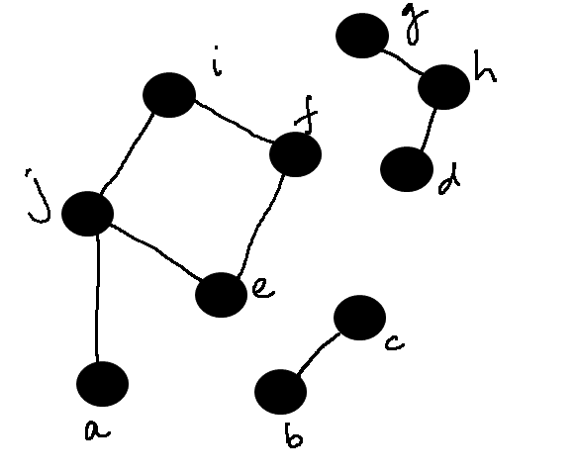
Data Structures Week 9
Example

Slide 181
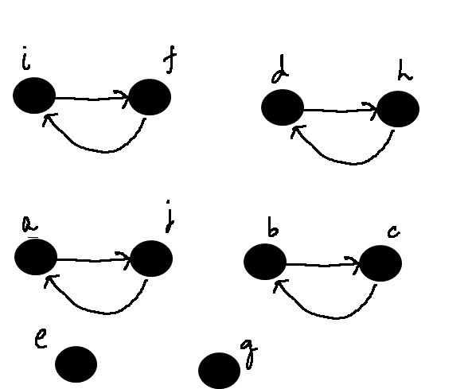
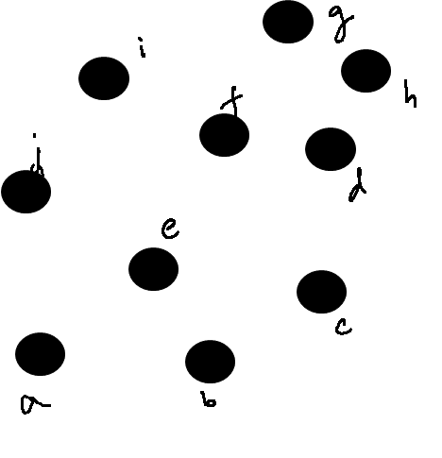
Data Structures Week 9
Example

Slide 182
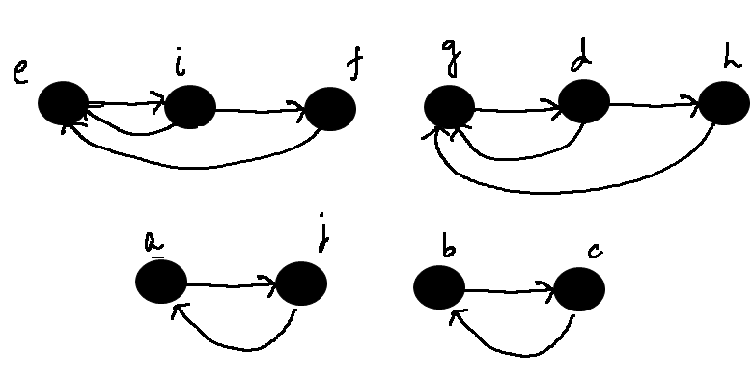
Data Structures Week 9
Example

Slide 183
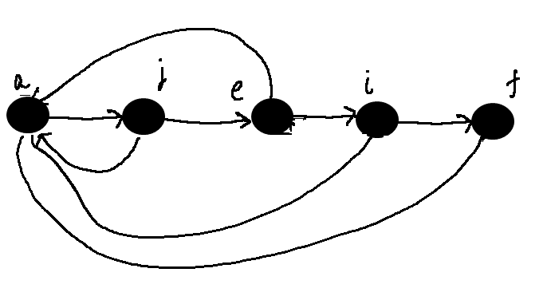
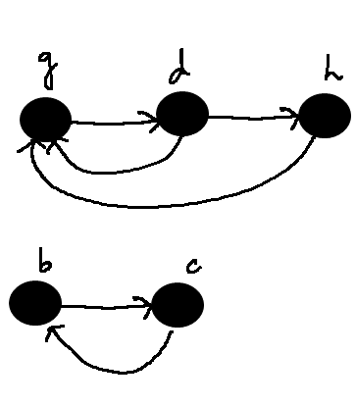
Data Structures Week 9
Example

Slide 184
Data Structures Week 9
Operations
How difficult is it to append the lists?
Claim: There exists a sequence of m operations on n objects so that the total time required for the entire sequence of operations is O(n²).

Slide 185
Data Structures Week 9
Operations
How difficult is it to append the lists?
Claim: There exists a sequence of m operations on n objects so that the total time required for the entire sequence of operations is O(n²).
After the first n MakeSet operations, call Union(x1,x2), Union(x2, x3), Union(x3, x4), …, Union(x_{n-1}, x_{n}).
The kth union call takes time proportional to k.
Total time is therefore O(n²).
The average time per operation is also O(n).

Slide 186
Data Structures Week 9
Application to Kruskal’s Algorithm
An average time of O(n) is not helpful for Kruskal’s algorithm.
We have several Union calls and several FindSet calls.

Slide 187
Data Structures Week 9
Better Solution
Most time spent is in the Union operation.
Can we modify the operation slightly?
Intuitively, it is easier to append a smaller list to a larger list.
  Required fewer updates.
  Will the overall time decrease?
We will show that indeed it does.

Slide 188
Data Structures Week 9
The Weighted Union Heuristic
Maintain the length of each list. Corresponds to the size of the set.
To perform Union(x, y):
  Append the list of x to the list of y if len(x) < len(y)
  Append the list of y to the list of x otherwise.
A single Union operation can still take lot of time.
  Union of two large lists, say of size n/10 each.
But, a sequence of operations may be not so expensive.
  Hopefully.

Slide 189
Data Structures Week 9
Analysis
How many times can an element change its representative?
Consider any element x.
If in an Union operation, the representative of x changes, then x is in the smaller list.
  Why?

Slide 190
Data Structures Week 9
Analysis
How many times can an element change its representative?
Consider any element x.
If in an Union operation, the representative of x changes, then x is in the smaller list.
  Why?
The first time this happens, the resulting list has at least 2 elements.

Slide 191
Data Structures Week 9
Analysis
How many times can an element change its representative?
Consider any element x.
If in an Union operation, the representative of x changes, then x is in the smaller list.
  Why?
The first time this happens, the resulting list has at least 2 elements.
Next time, the resulting list has at least 4 elements.

Slide 192
Data Structures Week 9
Analysis
In general, if the representative of x changes k times, then the resulting list has size at least 2^{k}.
The largest set can have a size of n.
Therefore, the representative of x cannot change more than log n times, over all the Union operations.
This applies to every element.
Therefore, over all Union operations, the total time spent is O(n log n).

Slide 193
Data Structures Week 9
Analysis
Now, consider a sequence of m operations.
MakeSet and Find are O(1) time operations.
Therefore, the total time is O(m + nlog n).
The average time per operation is O(log n).

Slide 194
Data Structures Week 9
Application to Kruskal’s Algorithm
Do n MakeSet operations indicating that each vertex is in its own tree/set.
To check if e = uv creates a cycle, check if FindSet(u) = FindSet(v).
If not, add e to the current tree. Perform Union(u, v) to merge the trees of u and v.
There are at most m FindSet operations.
Overall time is therefore bound by O(m+nlog n).

Slide 195
Data Structures Week 9
Graphs and Matrices
Today we will see an approach which views the graph as a matrix.
Matrix operations then map to graph operations, and vice-versa.
Called as algebraic graph theory.
We will see an application to the all pairs shortest paths problem.

Slide 196
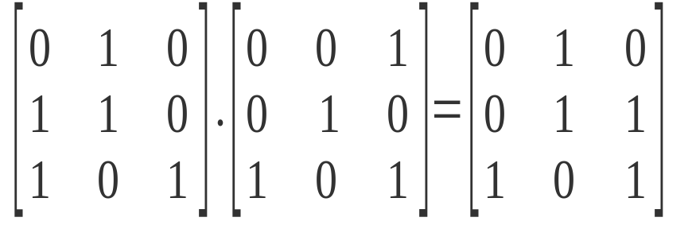
Data Structures Week 9
Basic Observations
Recall matrix multiplication.
Consider two square matrices A and B of size nxn each.
The matrix C = AxB is defined as:
  C[i,j] = Σ_{k} A[i,k].B[k,j]
Change the setting slightly:
  Boolean matrices : Entries are 0 or 1.
  Instead of multiply, take AND.
  Instead of addition, take OR.
  Example:

Slide 197
Data Structures Week 9
Implications to Graphs
Consider a directed graph G = (V,E) represented by its adjacency matrix A.
The matrix A is a Boolean matrix.
Consider the matrix A² = AxA.
When is A²[i,j] = 1 even when A[i,j] = 0?
  There is some index k such that A[i,k] = 1 and also A[k,j] = 1.
  In graph terms, vertices i and k are neighbors and vertices k and j are neighbors.
  Therefore, there is a path from i to j of length 2 even though i and j are not neighbors.
i
k
j

Slide 198
Data Structures Week 9
Further Extendible
By the same logic, A³ should be such that:
  A³[i, j] = 1 if and only if there is a path of length at most 3 between vertices i and j.
Extends all the way up to A^{n}.
Other applications of matrix based solutions:
  Number of spanning trees of a given graph G
  Number of matchings of a given graph G
  Random walks on graphs

Slide 199
Data Structures Week 9
Transitive Closure
Given a (directed) graph G = (V, E), for every vertex v, find the set of vertices reachable from v.
The notion of a closure is more mathematically well-defined.

Slide 200
Data Structures Week 9
Transitive Closure
Think of a matrix A_{T} of size nxn such that:
  A_{T} is a Boolean matrix.
  A_{T} [i,j] = 1 if and only if (i,j) is in the transitive closure.
  Notice that (i,j) is in the transitive closure if and only if there is a path of length at most n from i to j.
How to compute A_{T}?

Slide 201
Data Structures Week 9
Transitive Closure
Observe that A_{T} = A^{n}.
Why?

Slide 202
Data Structures Week 9
Transitive Closure
Observe that A_{T} = A^{n}.
Why?
To compute A^{n}, multiply A with itself repeatedly.
Can do in O(n³ log n)
Why?

Slide 203
Data Structures Week 9
Transitive Closure
Observe that A_{T} = A^{n}.
Why?
To compute A^{n}, multiply A with itself repeatedly.
Can do in O(n³ log n)
Why?
A highly parallel algorithm too.

Slide 204
Data Structures Week 9
Extension to Weighted Graphs
Suppose now that we have a weighted graph G = (V, E, W).
We want to find the shortest path between every pair of vertices.
Need to revise some of the above notions.

Slide 205
Data Structures Week 9
Extension to Weighted Graphs
Consider the graph A².
In the presence of multiple paths between vertices u and v, need to know the shortest.
Again, recall that A²[u,v] = Σ_{k} A[u,k] . A[k,v].
  In our setting for non-weighted graphs, multiplication is replaced by the Boolean AND
  Addition is replaced by Boolean OR.
How about weighted graphs?

Slide 206
Data Structures Week 9
Extension to Weighted Graphs
Instead of simply registering that there exists a k such that A[u,k] = 1 and A[k,v] = 1, need to know such a k* so that
  A[u,k*] + A[k*,v] is minimized at k*.
Suggests that the AND operations should now be the sum operation.
Also, the OR operation earlier should now be the MIN operation.
In essence, A²[u,v] = min_{k} A[u,k] + A[k,v].

Slide 207
Data Structures Week 9
Extends to Larger Paths Too
Need to compute A^{n} so that:
  Multiplication is replaced by addition
  Addition is replaced by minimum.

Slide 208
Data Structures Week 9
Program
Algorithm APSP(G)
Begin
A = A(G);
for i = 1 to log n do
A = Multiply(A,A);
end
end

Slide 209
Data Structures Week 9
Further Improvements
The current approach has a runtime of O(n³ log n).
In fact, it holds that any matrix multiplication algorithm can be used.
The current best for matrix multiplication is O(n^{2.6})
A slightly different approach gives a runtime of O(n³).

Slide 210
Data Structures Week 9
Further Improvements
The above approach works well for dense graphs.
For sparse graphs, there may be too much space wastage.
  Especially in sparse directed graphs.
New approaches are still under study.

Slide 211
Data Structures Week 9
Graphs of Present Interest
Some recent applications of graphs in computing are:
  Maps and directions.
  Train/Airline connection maps
  Internet
  Citation networks
  Biological networks
  Social networks such as Facebook, Orkut
Some characteristics:
  Large size, typically millions of vertices
  But, very few edges. Average degree is less than 10.
  Some vertices however have a very large degree.

Slide 212
Data Structures Week 9
Graphs of Present Interest
New problems of recent interest
  Path problems.
    Intuitively, vertices of degree 1 do not contribute to much of the computation.
    Very few options at every node of low degree.
    So new approaches that adapt to the graph models are of interest
  My current problem
    Imagine that you want to learn data structures for computational geometry.
    There are several ones and the list is ever expanding.
      Kd-trees, segment trees, R-tree,
    Cannot read all.
    But still want to quickly read the important ones.
    Which are these important ones?

Slide 213
Data Structures Week 9
Graphs of Present Interest
Find metrics on a given network
  H-index
  Erdos number
  Impact factor of a journal/conference
Some of these were homework problems in HW5.
Graph mining
  Imagine a call graph
  What kind of calls are relevant for an investigation?
Find popular nodes in a network.
  Defined by some notion of popularity

Slide 214
Data Structures Week 9
Summary
Graphs play an important role in computing.
We have only touched upon on some of the classical problems and their early solutions.
Current solution properties opened up several new problems and new solution approaches.
Further courses:
  Algorithms : Flows in networks,
  Language processing : Paths in directed graphs, the Viterbi algorithm
  Advanced Algorithms : Random walks on graphs, parallel graph algorithms
  Graph Theory* : matchings, colorings, random graphs,

